Slide 1
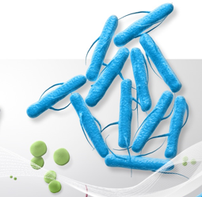
20th Genomic Standards Consortium Meeting Towards robust clinical use of NGS technology in small and large genomes
Han-Yu Chuang, PhD
Senior Manager, Bioinformatics and Genomic Applications Partnerships, Illumina Inc.

Slide 2
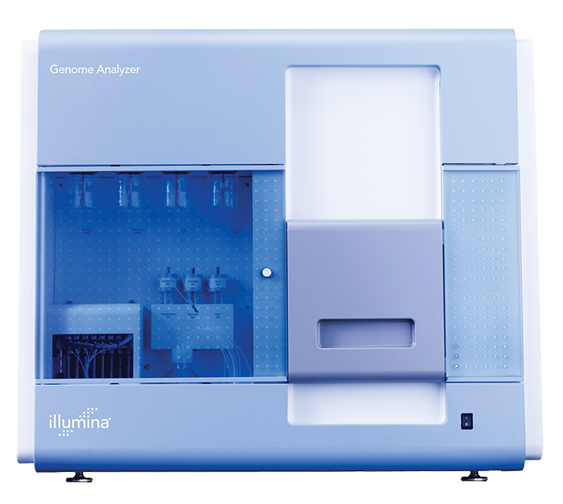
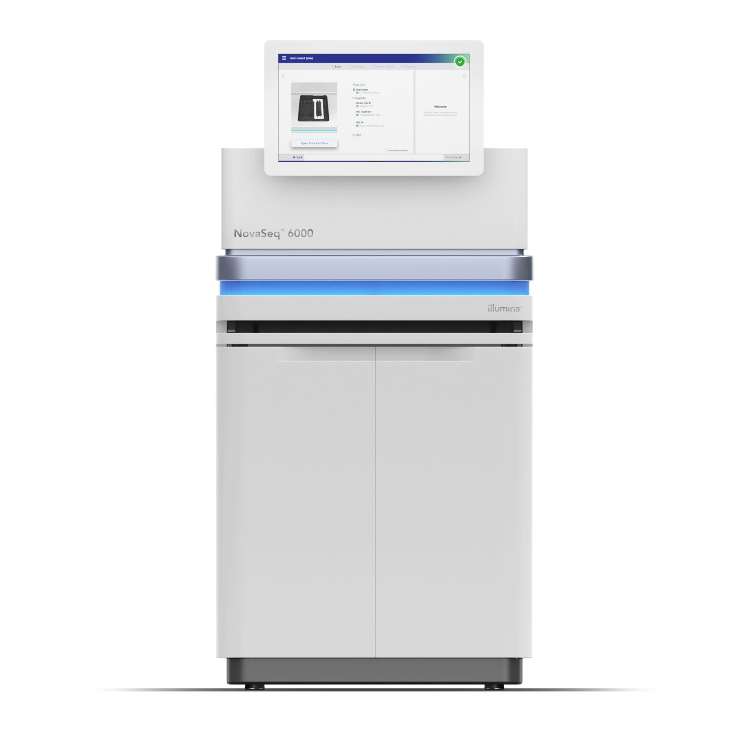
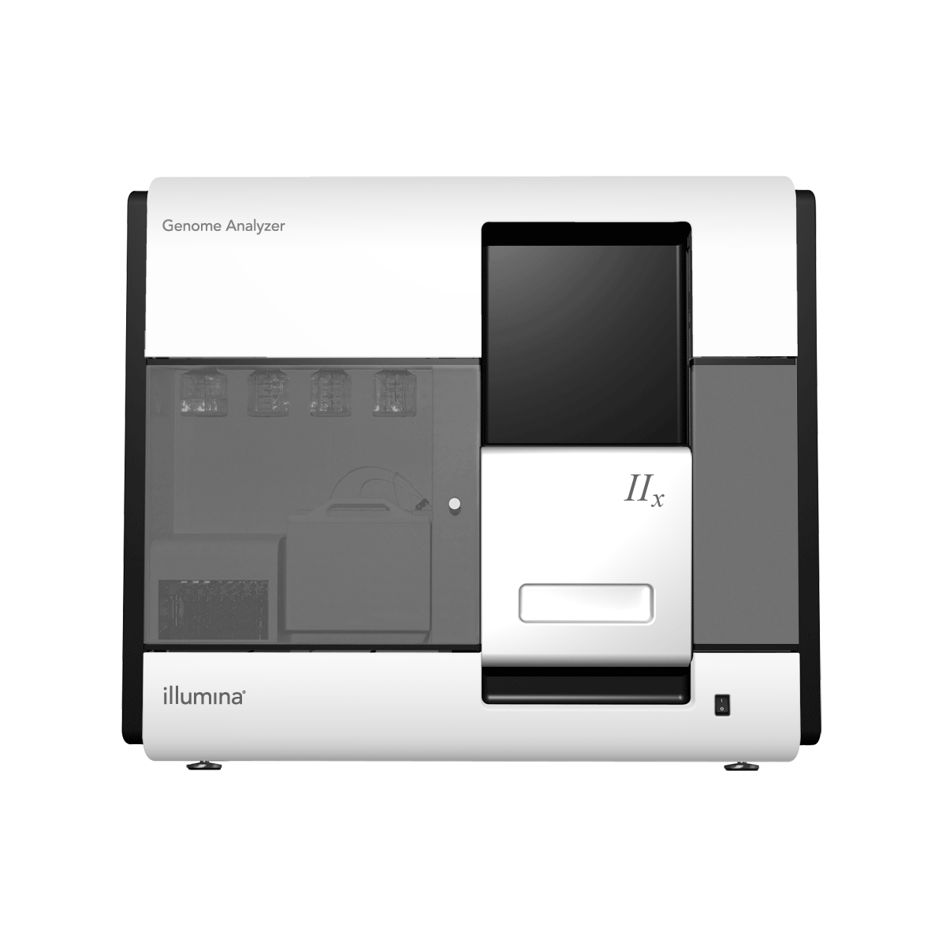
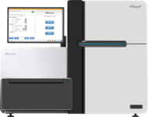
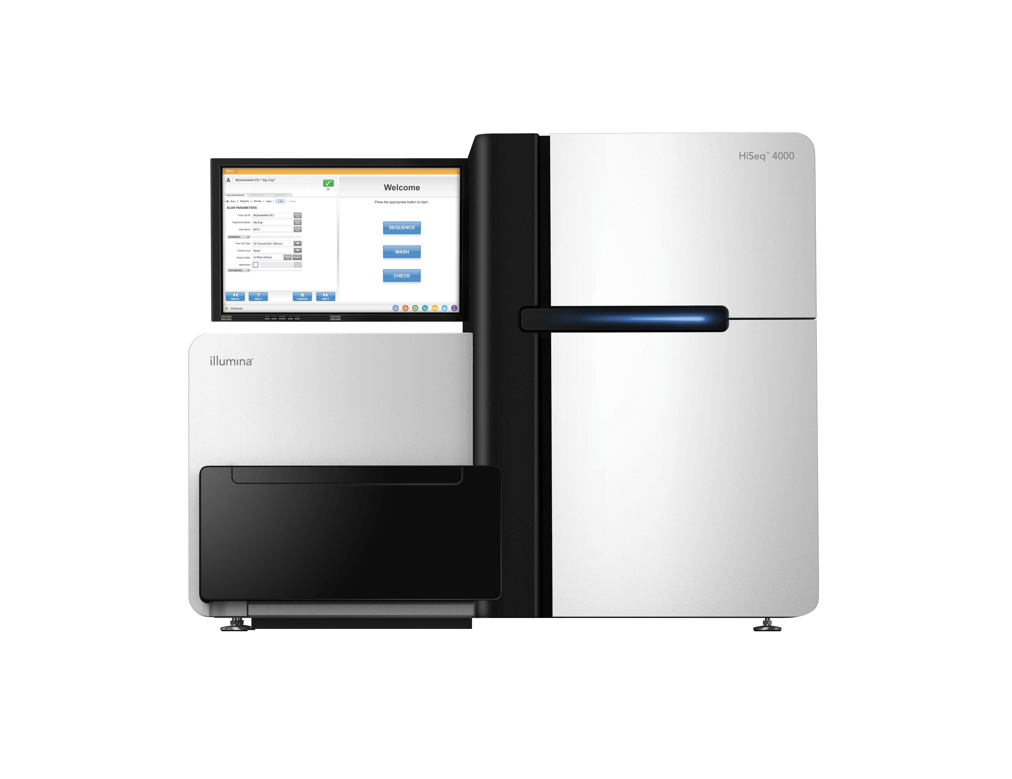
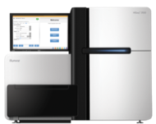
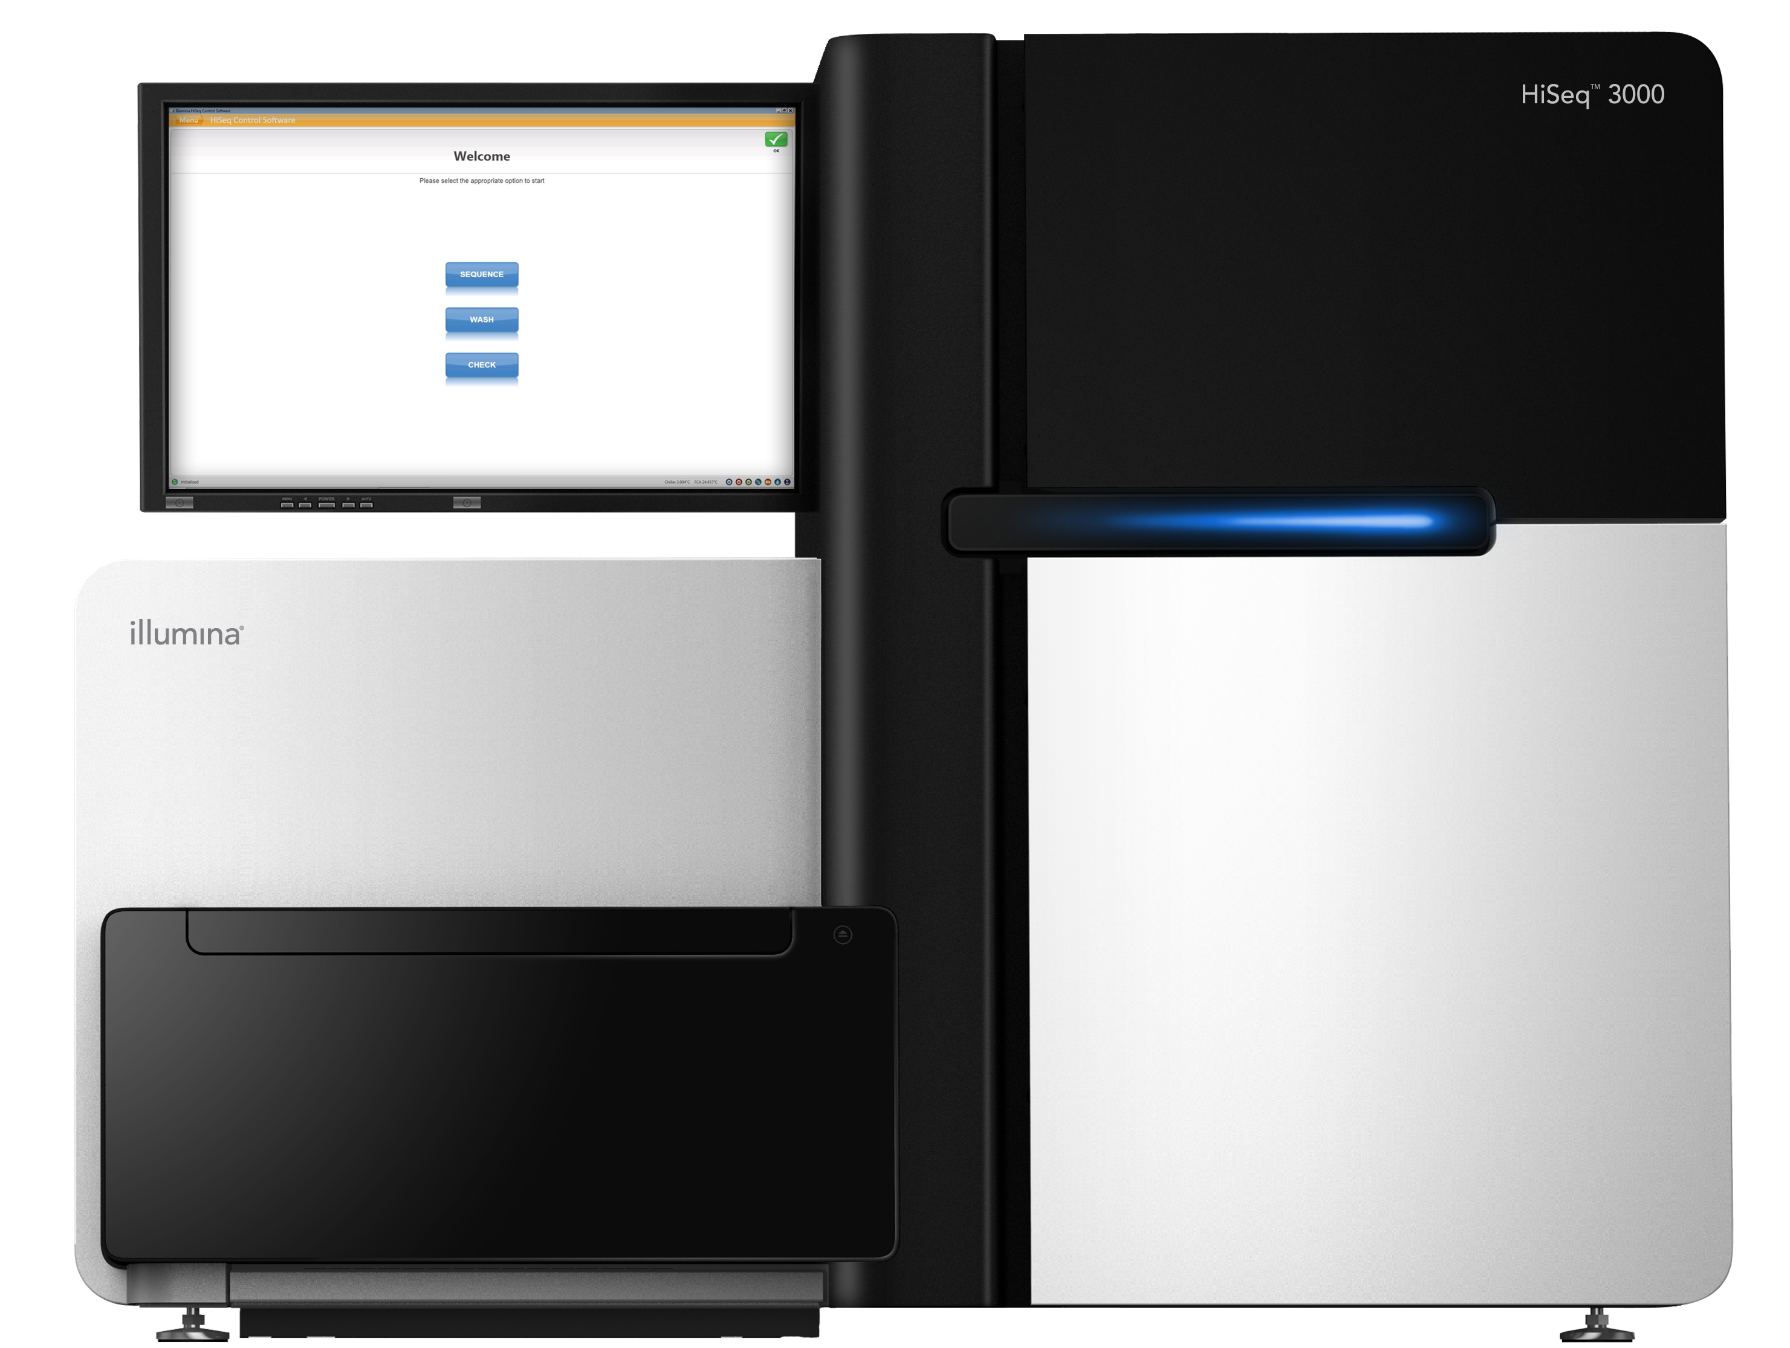
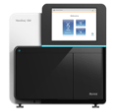
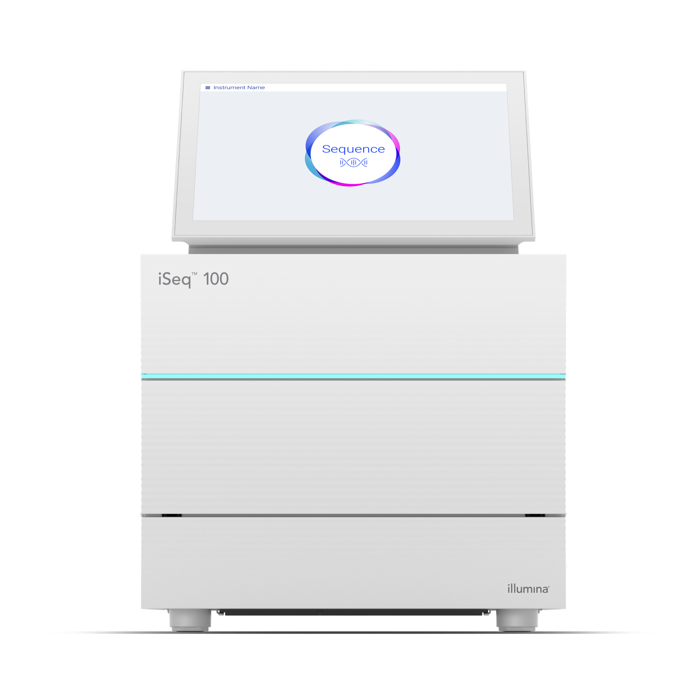
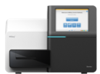

More than a Decade of NGS Innovation
Genome Analyzer™ (1G and IIx)
2007–2009
HiSeq™ 2000
2010
2011
MiSeq™
2012
HiSeq™ 2500
2014
HiSeq™ X Ten
NextSeq™
2015
HiSeq™ 3000/4000
2016
MiniSeq™
2017
NovaSeq™
iSeq™ 100
2018
Introduced SBS
Introduced PE module
8 lane, random seeding flow cell
Line scan imaging
High cluster density
Real time analysis
LED optics
Miniaturized fluidics
BaseSpace™ connectivity
Fast fluidics
Fast line scanning
Rapid Run Mode
Patterned flow cells
Exclusion-Amplification Chemistry
High speed scanning
2-channel SBS
Dry flow cell chemistry
Miniaturized optics
Modular design
Improved patterned flow cells
Extended applications
Single optics module
Integrated reagent cartridge
Onboard analysis
Modular design
Optimized for scale and cost
Custom camera and laser
New surface chemistry and dyes
New compute architecture
CMOS* sequencing
1 channel chemistry
*complementary metal-oxide semiconductor (CMOS)
Notes:
QB#5630

Slide 3


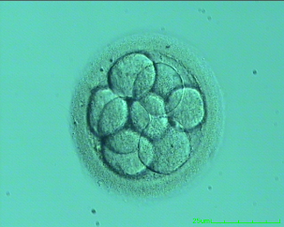
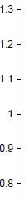

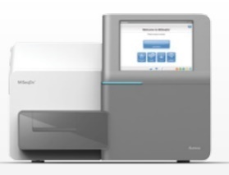


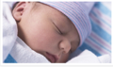




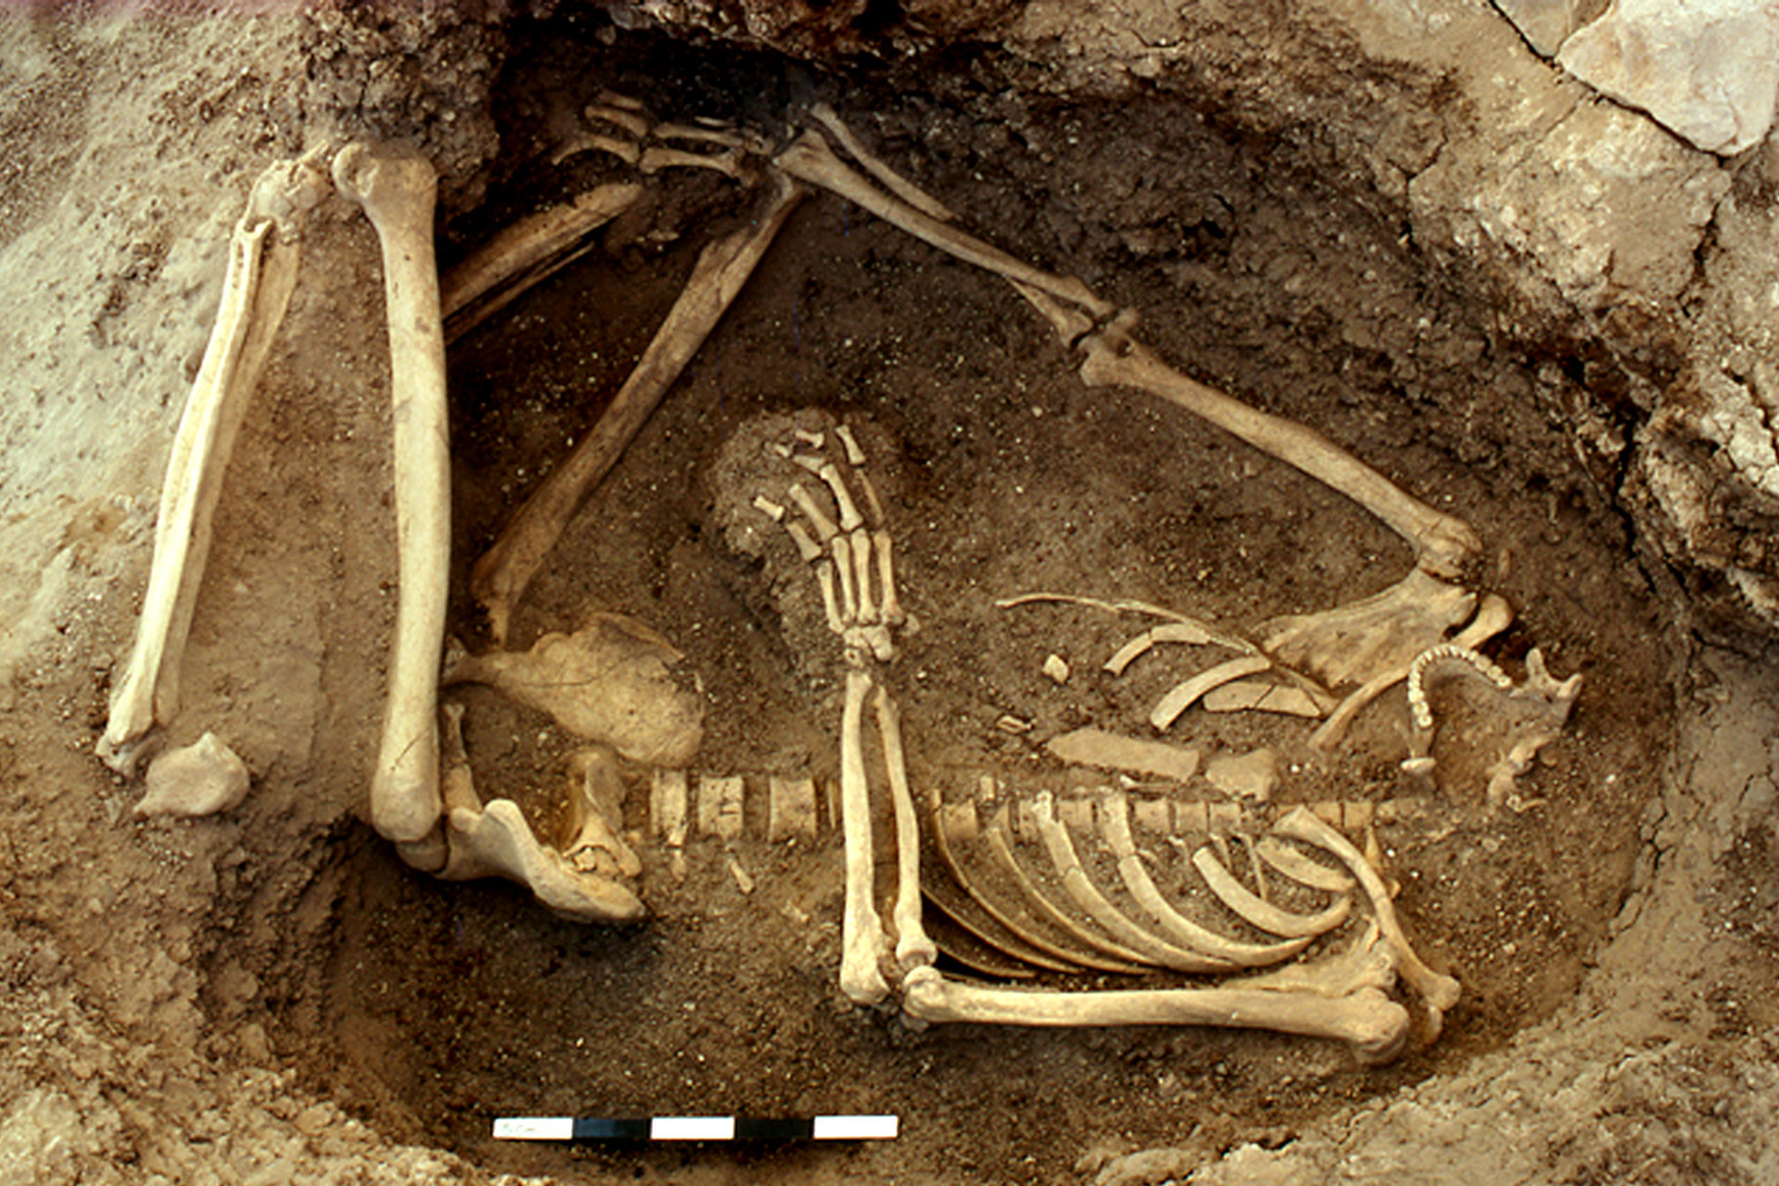









Foster Numerous Clinical Applications
TruSight™ One
TST15**
TruSight™ RNA Pan-Cancer
TruSight™ RNA Gene Fusion
TST170
TruSeq™ Methyl Capture EPIC
VeriSeq™ PGS
Ch 21
verifi®
Carrier Screening
Cystic Fibrosis Testing*
MiSeqDx®
1000 Genomes
ExAC
gnomAD
Conception
Birth
Biopsy
Relapse
Chemo
Death
Event
NIPT
Surgery
Metastasis
Relapse
Timeline
Sequencing
Single Cell Genomics
CNVs
RNA-Seq
Exome
Methyl-Seq
ATAC-Seq
ChIP-Seq
Molecular Autopsies
* For In Vitro Diagnostic Use.
** For Research Use Only. Not for use in diagnostic procedures.

Slide 4
Driving Standardization is in Our Best Interest
Effort in microbiology
Effort in human genomics
Factors on variant calling performance
DNA input, library conversion, sequencing depth
Things to watch out for in workflow validation
Apple-to-orange comparison
Reproducibility and Limt of Detection

Slide 5
Epidemiology and Whole-Genome Sequencing (WGS)

Slide 6

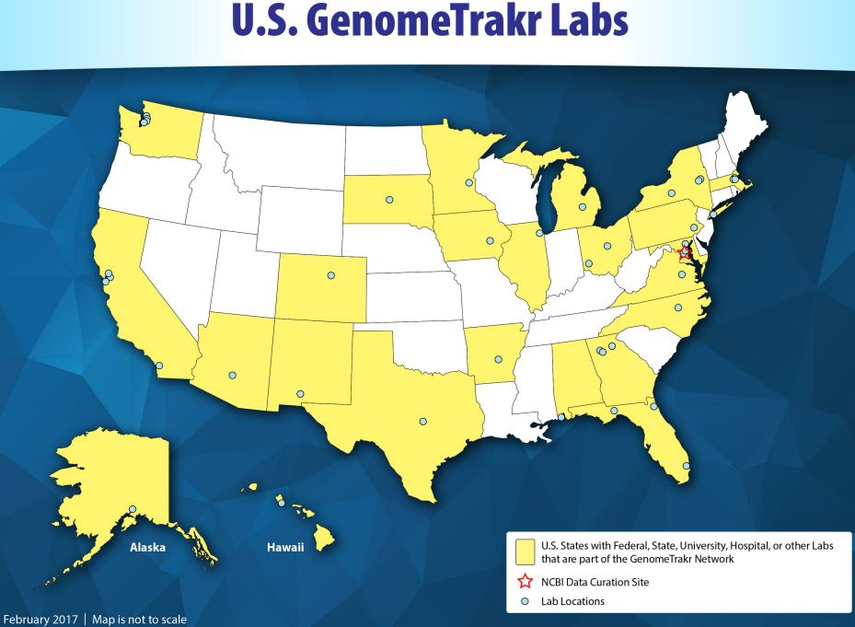
Two Laboratory Surveillance Systems In the USA That use WGS
Centers for Disease Control and Prevention
Food and Drug Administration
Adapted From: Slide courtesy of Eija Trees, CDC.
Notes:
ICE
Where FDA and USDA are regulatory agencies focusing in the food supply and manufacturing, the CDC focuses in the patients, those that have become ill from food exposure. It is the power and access to both these datasets that enables tracking down and reducing

Slide 7

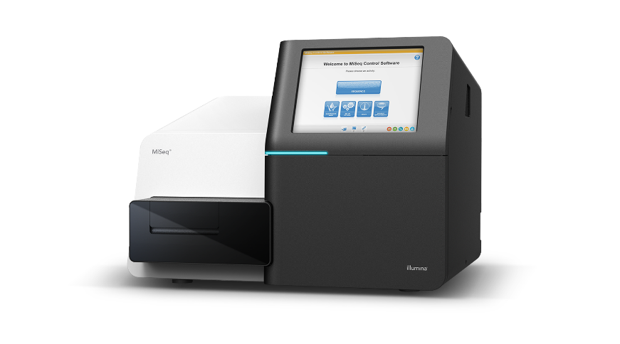
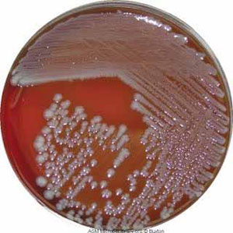


FDA Protocol Application: Bacterial WGS from culture
Sample
prep
Nextera® library prep
MiSeq® and primary analysis
Lyse cells from cultured isolate
Genomic DNA extraction
Nextera® XT
16 samples per run
~100x coverage
MiSeq® workflow
2 x 250
Generate FASTQ
Grow culture
Data sent to FDA or BaseSpace® for storage and sharing with FDA and upload to NCBI SRA database and analysis
Notes:
ICE

Slide 8
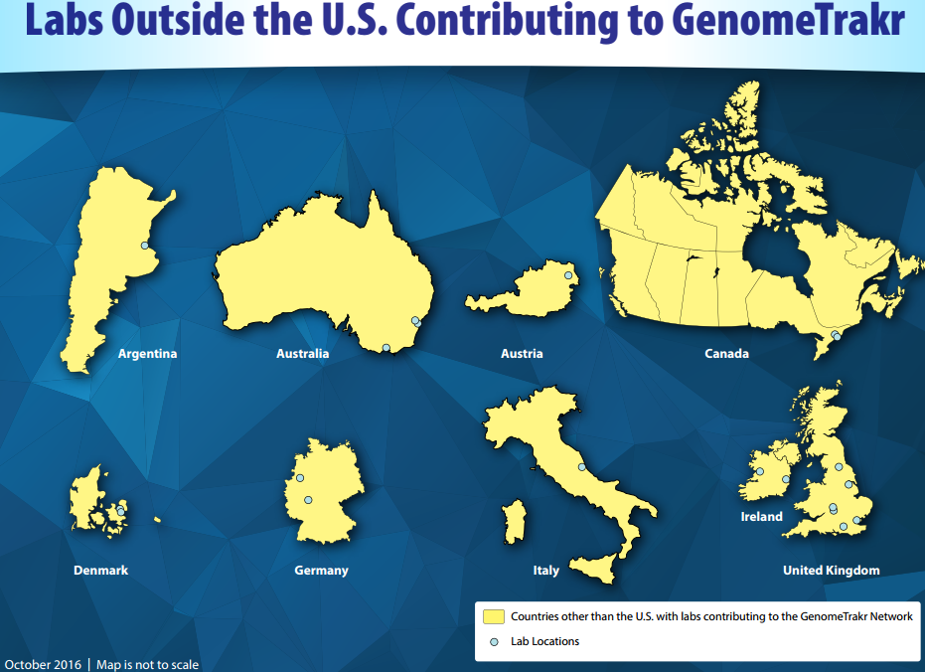
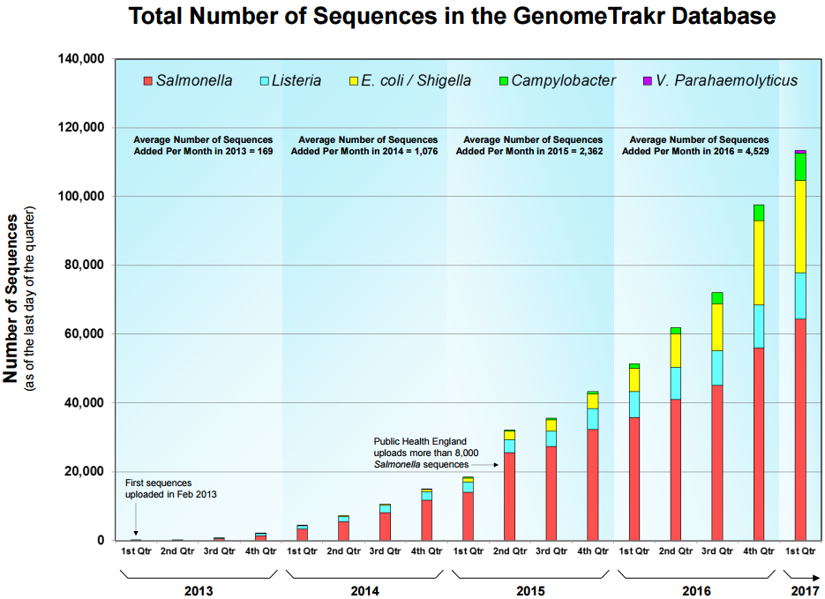
Total Number of Sequencing in the GenomeTrackr Database
http://www.fda.gov/Food/FoodScienceResearch/WholeGenomeSequencingProgramWGS/ucm363134.htm
Notes:
ICE

Slide 9
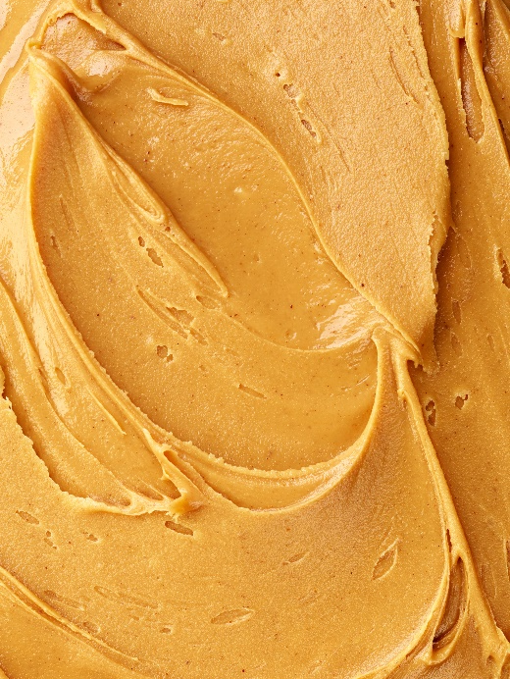
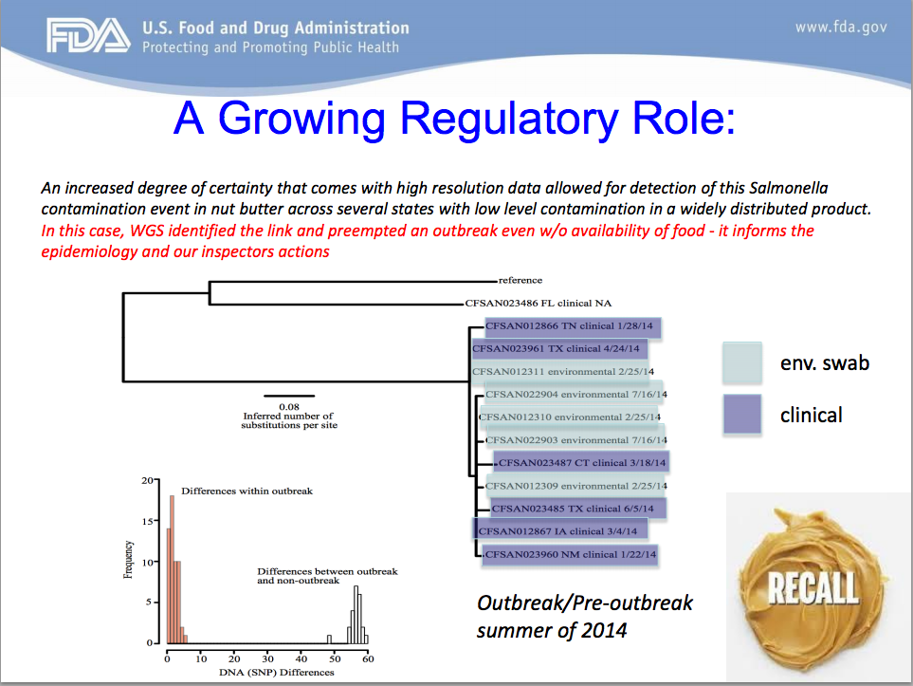

FDA: A Growing Regulatory Role
An increase degree of certainty that comes with high resolution data allowed for detection of this Salmonella contamination event in nut butter across several states with low level contamination and a widely distributed product
Outbreak / Pre-outbreak summer of 2014
Reference
CFSAN023486 FL clinical NA
CFSAN012866 TN clinical 1/28/14
CFSAN023961 TX clinical 4/24/14
CFSAN012311 environmental 2/25/14
CFSAN022904 environmental 7/16/14
0.08
Inferred number of substitutions per site
CFSAN012310 environmental 2/25/14
CFSAN022903 environmental 7/16/14
CFSAN023487 CT clinical 3/18/14
CFSAN012309 environmental 2/25/14
Env. swab
CFSAN023485 TX clinical 6/5/14
Clinical
CFSAN012867 IA clinical 3/4/14
CFSAN023960 NM clinical 1/22/14
In this case, WGS identified the link and preempted an outbreak even without availability of food – it informs the epidemiology and our inspectors actions
Adapted From: Slide produced by David White, FDA
Notes:
ICE
And a great example of this happened in the summer of 2014 with a regular inspection of the nut butter facility.

Slide 10
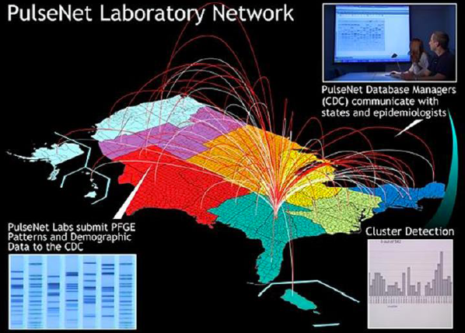
Foodborne Disease Surveillance
~48m
foodborne illnesses occur in the U.S. each year
Although most cases occur as part of unrecognized outbreaks
>1,000
outbreaks are reported each year
Results:
~128,000
3,000
hospital admissions
deaths
PulseNet, a national network of public health and food regulatory agency laboratories, has played a key role in identifying and stopping outbreaks of foodborne illnesses
Pathogens/Foods linked to most foodborne illnesses
Campylobacter (poultry)
E. coli O157 (ground beef, leafy greens, raw milk)
Listeria (deli meats, unpasteurized soft cheeses, produce)
Salmonella (eggs, poultry, meat, produce)
Vibrio (raw oysters)
Norovirus (common in many foods)
Toxoplasma (meats)
Adapted From: Slide courtesy of Duncan MacCannell, CDC
Notes:
ICE

Slide 11
How Illumina is Making a Difference In Food Safety
Listeria Cluster Metrics Pre/Post WGS
No. of clusters detected
No. of clusters detected sooner or only by WGS
No. of outbreaks solved (food source identified)
Median no. of cases per cluster
No. of cases linked to food source
Pre-WGS (Sept 2012–Aug 2013)
WGS Year 1 (Sept 2013–Aug 2014)
WGS Year 2 (Sept 2014–Aug 2015)
Adapted From: Jackson et al. 2016
Notes:
ICE

Slide 12
SEquencing Quality Control Consortium Led by FDA

Slide 13
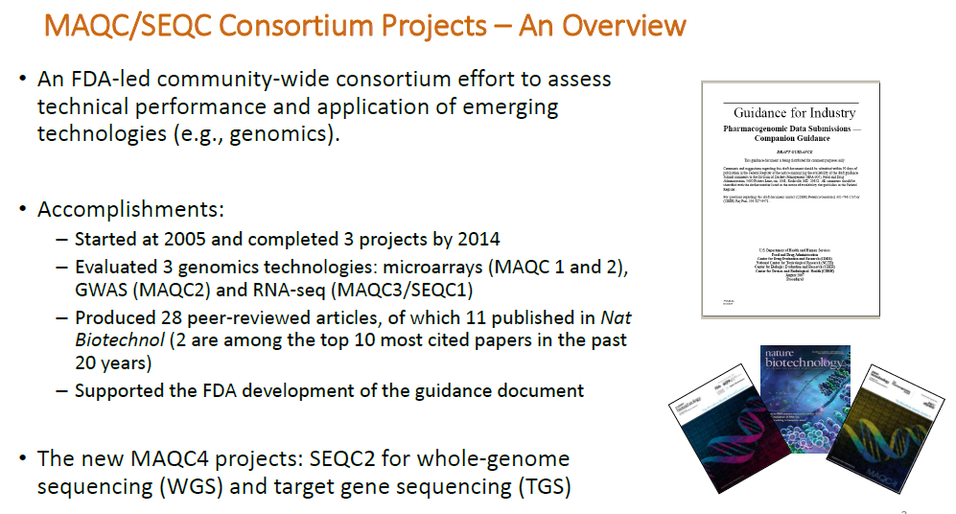
Led by Division of Bioinformatics and Biostatistics at FDA’s National Center for Toxicological Research (NCTR/FDA)

Slide 14
SEquencing Quality Control Phase 2
Develop standard analysis protocols and quality control metrics for fit‐for‐purpose use of NGS data to enhance regulatory science research and precision medicine
Develop quality metrics for reproducible NGS results from both whole genome sequencing (WGS) and targeted gene sequencing (TGS)
Benchmark bioinformatics methods for WGS and TGS towards the development of standard data analysis protocols
Assess the joint effects of key parameters affecting NGS results and interpretation for clinical application
Reference Samples Characterized | Working Group Focus | Technology Utilized | Key Members besides Illumina
HCC1395 (ATCC® CRL-2324™) HCC1395 BL (ATCC® CRL-2325™) | WG1: somatic mutations (tumor/normal analysis) WG5: genome assembly | Illumina WGS, Agilent WES, 10X WGS, PacBio WGS, RNA-seq, Single cell | Mayo Clinic, NCI, NCBI, HudsonAlpha, LLU, EATRIS, Fudan U., Novartis, Garvan, Genetech, Weill Cornell, ATCC, Yale, Roche, DNAnexus, Seven Bridges, Sentieon
10 UHRR cell lines | WG2: targeted deep sequencing for pan-cancer and liquid biopsy | Main: TGS Pilot: WES, TGS, 10X WGS, aCGH, ddPCR Peripheral: spike-in, FFPE, RNA | Roche, IDT, Agilent, Qiagen, iGeneTech, Thermo Fisher, Accugenomics, EA/Q2, Horizon, NCBI, NHS
HapMap, Chinese | WG3: germline variants (trio/quartet analysis) | NGS: WGS, 10X WGS, PacBio WGS Array: Affymetrix, Illumina 1M-Duo | CapitalBio, NVG, WUX, ARD, CoGenics, CMM, EA, Northwest U, Riken, Roche, DNAnexus, Seven Bridges, Sentieon
NA12878 | WG7: epigenetics | WGBS, methyl capture seq | Weill Cornell, EATRIS, etc

Slide 15
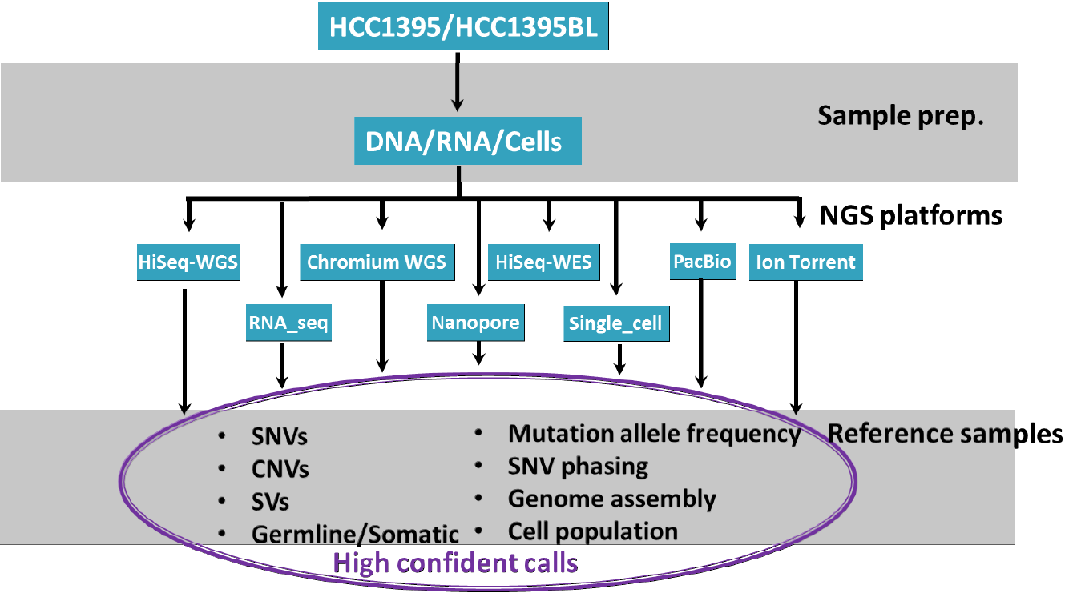
Multi-omics for Reference Characterization
Example from WG1 for somatic mutation detection
For Research Use Only. Not for use in diagnostic procedures.

Slide 16
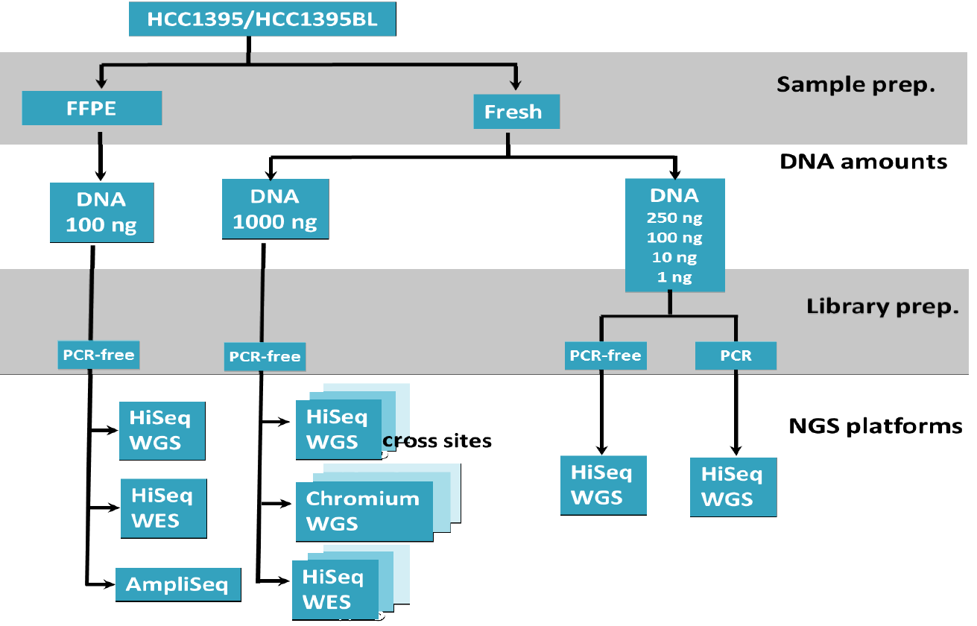
Assessing Impacting Factors
Example from WG1 for somatic mutation detection
For Research Use Only. Not for use in diagnostic procedures.

Slide 17
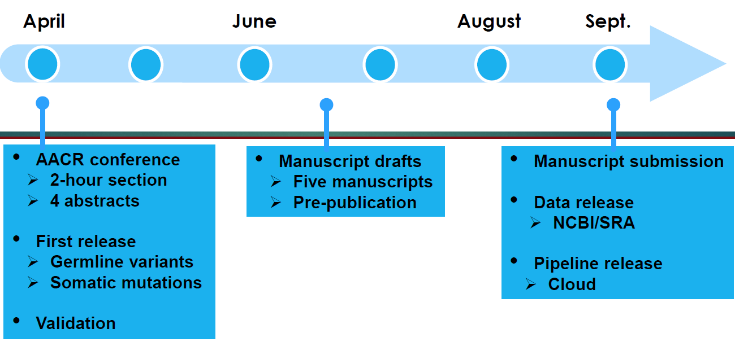
Result Sharing with Community
Example from WG1 for projected timeline

Slide 18
Factors on Variant Calling Performance

Slide 19
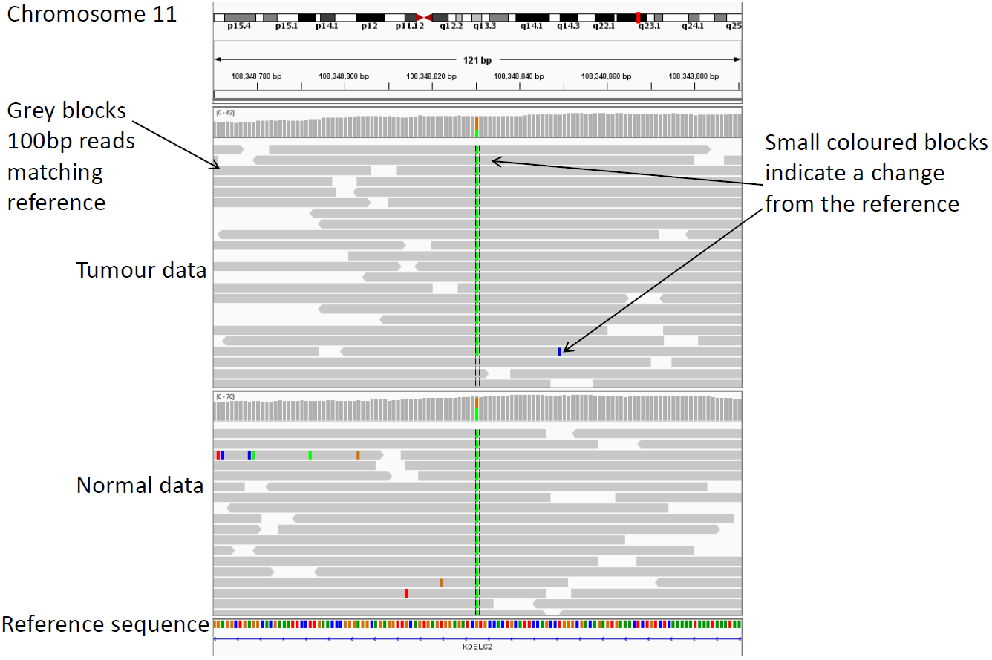
Variant Calling: Distinguishing Signals from Noises
Signal?
Noise?
Robinson et al. 2011
Notes:
QB#5665

Slide 20
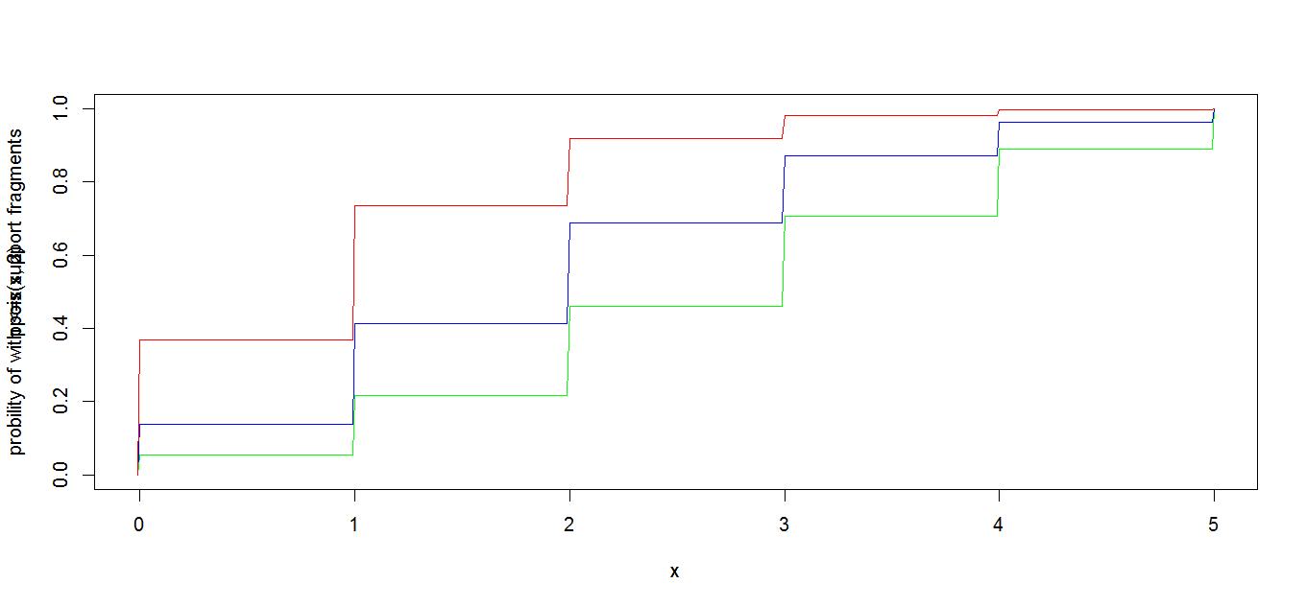
Sufficient Sampling to See The Signal
1 haploid human genome = 3.3pg
1ng DNA input = 303 haploid genomic equivalents (hGE)
Regardless noise level, for 0.1% MAF mutations
Probability of seeing ≤x supporting fragments
At 1000 hGE, 37% with 0x supporting fragment
1000 hGE or 1000x
2000 hGE or 2000x
3000 hGE or 3000x
At 2000 copies, 14% with 0x supporting fragment
At 3000 copies, 5% with 0x supporting fragment
Variant supporting fragment counts
*Data calculations on file. Illumina, Inc. 2018
Notes:
QB#5665

Slide 21
Library Diversity for Sufficient Sampling
Theoretical LoD under different input DNA mass and library conversion efficiency
 |  | DNA input
 |  | 1ng | 10ng | 20ng | 30ng | 50ng | 100ng
library conversion efficiency | 20% | 5% | 0.5% | 0.25% | 0.17% | 0.1% | 0.05%
 | 30% | 3.4% | 0.34% | 0.17% | 0.12% | 0.07% | 0.04%
 | 50% | 2% | 0.2% | 0.1% | 0.07% | 0.04% | 0.02%
 | 100% | 1% | 0.1% | 0.05% | 0.04% | 0.02% | 0.01%
Assumptions:
1ng DNA contains 300 haploid genomes
LoD is the minimum VAF that gives at least 95% likelihood to observe one or more mutant DNA templates
*Data calculations on file. Illumina, Inc. 2018
Notes:
QB#5665

Slide 22
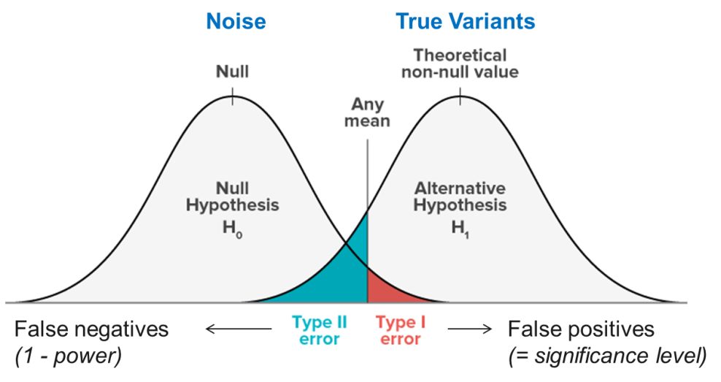
Clear Separation in Sample Distribution between Signals and Noises
Notes:
QB#5665

Slide 23
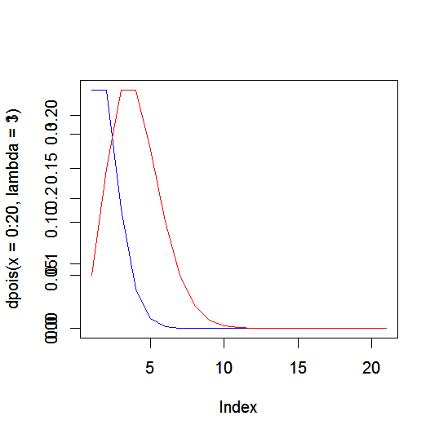
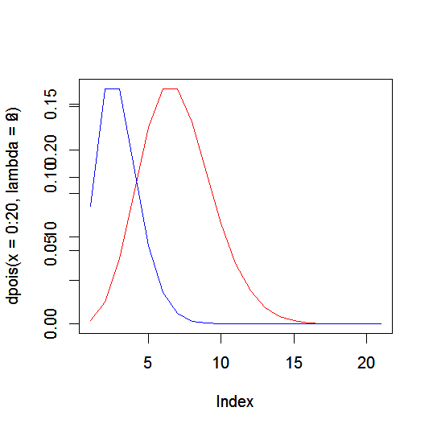
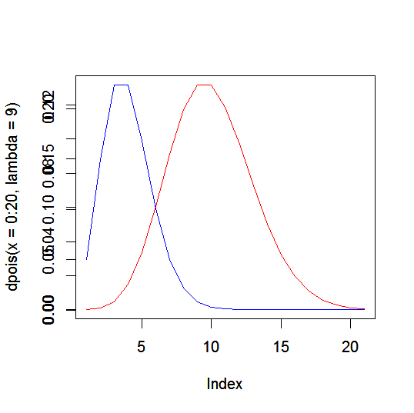
Right Input Mass and Sequencing Depth Together for Sensitivity and Specificity
Fragment coverage
depth at a locus
3000x
DNA input | Library conversion
15ng | 60%
30ng | 30%
Red: signal of VAF=0.1%
Blue: noise of VAF=0.033%
Assume Poisson for fragment distribution
Type I error =5% with FN rate = 50%
6000x
DNA input | Library conversion
30ng | 60%
60ng | 30%
Frequency
Type I error =5% with FN rate = 29%
9000x
DNA input | Library conversion
45ng | 60%
90ng | 30%
Type I error =5% with FN rate = 12%
5
10
15
20
Variant supporting fragment counts
*Data calculations on file. Illumina, Inc. 2018
Notes:
QB#5665

Slide 24
Things to Watch out for in Validation

Slide 25
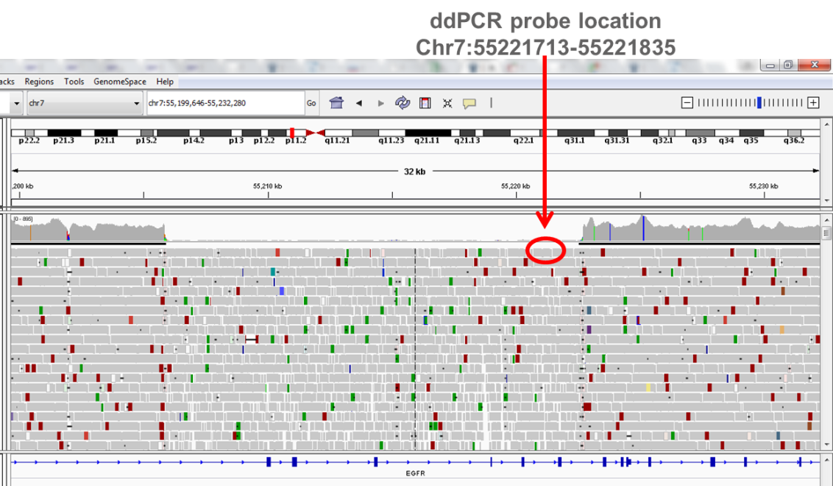
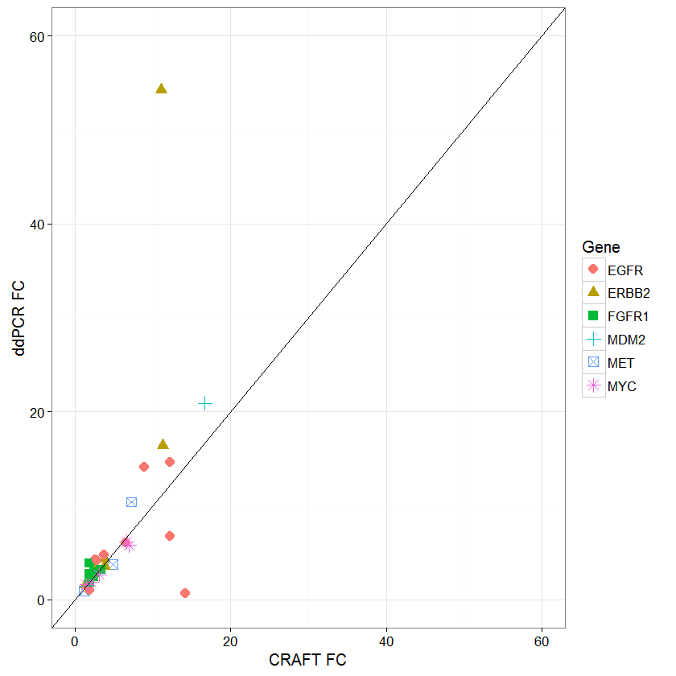
Understand the Assay Limit to Avoid Apple-to-Orange Assessment
High concordance between CNV calls from TST170 and ddPCR
22 FFPE samples tested
ddPCR fold change
Another example:
Sanger sequencing can only go down to 20% VAF
So negative by Sanger ≠ reference calls
TST170 fold change
Notes:
QB#5665

Slide 26
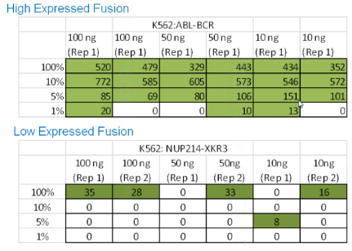
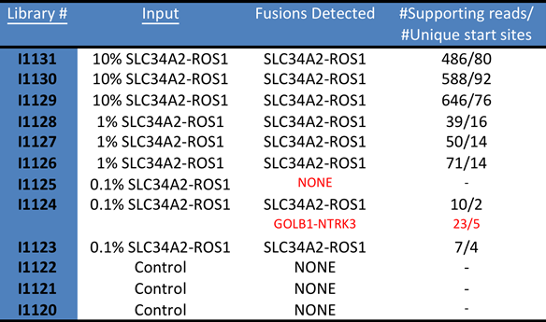
Limit of Detection for RNA Variants is Tricky
Problem: Every gene has different endogenous expression levels
Unlike DNA which is mostly diploid, RNA expression differs between genes and between cells
LoD relative to wild type is not comparable across genes
Fusion sensitivity analysis in majority literature
Every fusion gene has different expression level in the same samples
Cell line HCC-78 was diluted in Ambion® lung background (200ng total RNA)
Panel with 119 targets (ALK, BDNF, NGF, NGFR, NTF3, NTRK1, 2, & 3, RET and ROS
LoD as dilution of a certain cell line is not comparable across variants

Slide 27
Reproducibility
Reproducibility should NOT be a simple concordance analysis between two results, without an understanding of the sample used
Variant calls near limit of detection are expected to have certain likelihood to be missed randomly from run to run
The concordance shall be benchmarked against a panel of confirmed variants, or carefully calculated on those sites with observed VAF at 2~3x of LoD

Slide 28
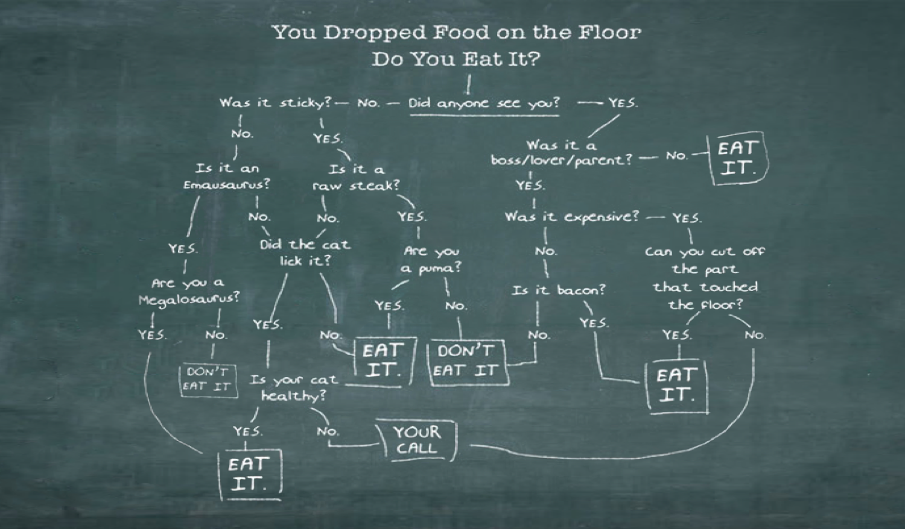
At The End of The Day, We All Want to Know…
THANK YOU!
Notes:
ICE

